Slide 1
Creating Packages, Interfaces, JAR files and Annotations
Ms. Deepthi S Narayan

Slide 2
Creating Packages
A java package is a group of similar types of classes, interfaces and sub-packages.
Package in java can be categorized in two form, built-in package and user-defined package

Slide 3
Advantages of Packages
1) Java package is used to categorize the classes and interfaces so that they can be easily maintained.
2) Java package provides access protection.
3) Java package removes naming collision.

Slide 4
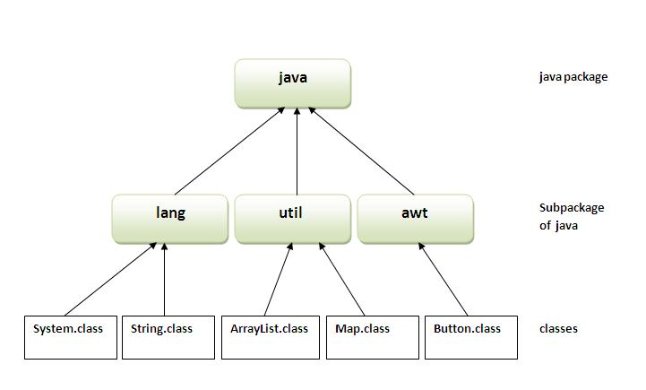

Slide 5
The package keyword is used to create a package in java.
javac -d directory javafilename
The -d switch specifies the destination where to
put the generated class file. Examples Folder
You need to use fully qualified name to run the class.
e.g. mypack.Simple

Slide 6
How to access package from another package
There are three ways to access the package from outside the package.
import package.*;
import package.classname;
fully qualified name

Slide 7
Using packagename.*
If you use package.* then all the classes and interfaces of this package will be accessible but not subpackages.
The import keyword is used to make the classes and interface of another package accessible to the current package

Slide 8
Using packagename.classname
If you import package.classname then only declared class of this package will be accessible.

Slide 9
Using fully qualified name
If you use fully qualified name then only declared class of this package will be accessible. Now there is no need to import. But you need to use fully qualified name every time when you are accessing the class or interface.
It is generally used when two packages have same class name e.g. java.util and java.sql packages contain Date class.

Slide 10
Interfaces v/s Classes
You cannot instantiate an interface.
An interface does not contain any constructors.
All of the methods in an interface are abstract.
An interface cannot contain instance fields. The only fields that can appear in an interface must be declared both static and final.
An interface is not extended by a class; it is implemented by a class.
An interface can extend multiple interfaces.

Slide 11
Interfaces have the following properties
An interface is implicitly abstract. You do not need to use the abstract keyword when declaring an interface.
Each method in an interface is also implicitly abstract, so the abstract keyword is not needed.
Methods in an interface are implicitly public.

Slide 12
Partially Implementing an Interface
Whenever an interface is partially implemented, that particular class must be made abstract
Example – Interface1
AbstractInterface implements Interface1
Implementation extends AbstractInterface
MainClass

Slide 13
Extending Multiple Interfaces
InterfaceA and InterfaceB
TestInterface
TestClass
Ex: Sample implements IA and IB

Slide 14
Creating JAR file
A Java Archive(JAR)file enables us to enclose a number of files into one.
JAR files compress their contents using the ZIP format
We can also digitally sign the files in a JAR file to prove their origin.
JAR files are created with Jar tool
jar [options] [manifest] destination input-file [additional input files]

Slide 15
JAR file – Heads-Up!
The JarFile class is used to read the contents of a jar file from any file that can be opened with java.io.RandomAccessFile.
It extends the class java.util.zip.ZipFile with support for reading an optional Manifest entry.
The Manifest can be used to specify meta-information about the jar file and its entries.

Slide 16
Creating JAR file
jar command in Java allows you to create jar file from command prompt, what is required is that you must have jar command included in System PATH variable
jar -cvf HelloWorld.jar HelloWorld.class
added manifest
adding: HelloWorld.class

Slide 17
Possible options with jar tool
c – It creates a new or empty archive on the standard output
t – It lists the table of contents from standard output
x file – It extracts all files or just the named files
f – The argument following this option specifies a JAR file to work with
v – It generates Verbose output on stderr
m – includes manifest information from a specified manifest file

Slide 18
O – It includes “store only”, - without using ZIP compression
m – It specifies that a manifest should not be created for the entries.
u – It updates an existing JAR file by adding files or changing the manifest.
C – Changes directories during execution of the jar command.

Slide 19
This will also create manifest file but without Main-Class entry as shown below
cat MANIFEST.MF
Manifest-Version: 1.0
Created-By: 1.6.0-beta2 (Sun Microsystems Inc.)
To run,
java -jar HelloWorld.jar

Slide 20
Creating the executable jar file
jar -cvfe HelloWorld.jar HelloWorld HelloWorld.class
To view the contents of a jar file in java
jar -tf HelloWorld.jar
Extracting the contents of jar file
jar -xf HelloWorld.jar

Slide 21
Creating an Executable JAR file
A jar file created with a main class manifest can be used both as a library and a runnable jar.
If you use it as a library, you can edit and compile any of the classes included in the jar, and add it to your project

Slide 22
Creating the manifest file
A manifest file in computing is a file containing metadata for a group of accompanying files that are part of a set.
To create manifest file, you need to write Main-Class, then colon, then space, then classname then enter.
Example:myfile.mf
Main-Class: First

Slide 23
How to create JAR in eclipse
1) Select Project for which you want to create jar file.
2) Go to File Menu and select Export
3) Expand Java folder and select JAR file

Slide 24
Reading JAR Files in Code/Hierarchy
JarFile class
Extends java.util.zip.ZipFile class
The JarFile class is built on top of the ZipFile class
java.lang.Object
java.util.zip.ZipFile
java.util.jar.JarFile
Web Reference - https://docs.oracle.com/javase/7/docs/technotes/tools/windows/jar.html

Slide 25
The New java.lang Subpackages
java.lang.annotation
java.lang.instrument
java.lang.management
java.lang.reflect

Slide 26
java.lang.annotation subpackage
Java's new annotation facility is supported by this package. It defines the Annotation interface, the ElementType and RetentionPolicy enumerations.
Annotation is metadata
Why Annotations?

Slide 27
java.lang.instrument Subpackage
Defines the features that can be used to add instrumentation to various aspects of program execution.
ClassFileTransformer - An agent provides an implementation of this interface in order to transform class files.
Instrumentation - This class provides services needed to instrument Java programming language code.
ClassDefinition class

Slide 28
java.lang.instrument package
We can access a class that is loaded by the Java classloader from the JVM and modify its bytecode by inserting our custom code, all these done at runtime.

Slide 29
Key Components of Java Instrumentation
Agent – is a jar file containing agent and transformer class files.
Agent Class – A java class file, containing a method named ‘premain’.
Manifest – manifest.mf file containing the “premain-class” property.
Transformer – A Java class file implementing the interface ClassFileTransformer.

Slide 30
java.lang.management Sub package
Provides management support for the JVM and the execution environment.
It allows both local and remote monitoring and management of the running Java virtual machine.
Various aspects of program execution can be observed and managed using the features of this package

Slide 31
java.lang.reflect Sub package
Provides classes and interfaces for obtaining reflective information about classes and objects.
Reflection is the ability of software to analyze itself.
Reflection is a language's ability to inspect and dynamically call classes, methods, attributes, etc. at runtime.
It has around 8 classes and 9 interfaces

Slide 32
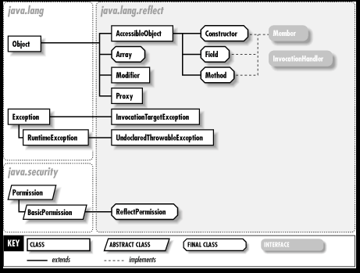

Slide 33
Annotation Basics
Writing annotations is very simple. You can compare annotation definition to an interface definition.
An @ precedes the annotation type declaration.
Built-in Annotations and Customized/User-Defined Annotations
Annotations only support primitives, string and enumerations. All attributes of annotations are defined as methods and default values can also be provided

Slide 34
Annotation Syntax
1.Declaration Syntax
@interface Annotation_name {
members---------------
}
2. Utilization Syntax
for variables, methods, classes..
@Annotation_name(member1=value1, member2=value2...)
programming element

Slide 35
Ex: @interface Todo {
public enum Priority {LOW, MEDIUM, HIGH}
public enum Status {STARTED, NOT_STARTED}
String author() default "Yash";
Priority priority() default Priority.LOW;
Status status() default Status.NOT_STARTED;
}

Slide 36
Points to Remember
Method should not have any throws clauses
Method should return one of the following: primitive data types, String, Class, enum or array of these data types.
Method should not have any parameter.
We should attach @ just before interface keyword to define annotation.
It may assign a default value to the method.

Slide 37
Built-in Annotations
@Override - is used above methods that override methods from a superclass.
@Deprecated - is used to mark a class, method or field as deprecated, meaning it should no longer be used.
@SuppressWarnings - makes the compiler suppress warnings for a given method.
@Inherited - Whether subclasses gets the annotation. Can be used only on another annotation declaration.

Slide 38
Built-in Annotations
@Target - Places the annotation can go. Specifies the type of declaration to which an anotation can be applied.
@Documented - Whether to put the annotation in Javadoc
@Retention - When the annotation is needed

Slide 39
What is Retention policy in java annotations?
A retention policy determines at what point annotation should be discarded.
Java defined 3 types of retention policies through java.lang.annotation.RetentionPolicy enumeration. It has SOURCE, CLASS and RUNTIME.
Annotation with retention policy SOURCE will be retained only with source code, and discarded during compile time.
Annotation with retention policy CLASS will be retained till compiling the code, and discarded during runtime. (default)
Annotation with retention policy RUNTIME will be available to the JVM through runtime.
The retention policy will be specified by using java built-in annotation @Retention, and we have to pass the retention policy type.

Slide 40
@Target Annotations
Specifies which Java elements your custom annotation can be used to annotate
The ElementType class contains the following possible targets:
ElementType.ANNOTATION_TYPE
ElementType.CONSTRUCTOR
ElementType.FIELD
ElementType.LOCAL_VARIABLE
ElementType.METHOD
ElementType.PACKAGE
ElementType.PARAMETER
ElementType.TYPE

Slide 41
Example for @Target
import java.lang.annotation.ElementType;
import java.lang.annotation.Target;
@Target({ElementType.METHOD})
public @interface MyAnnotation {
String value();
}

Slide 42
@Inherited
The @Inherited annotation signals that a custom Java annotation used in a class should be inherited by subclasses inheriting from that class.
Ex: java.lang.annotation.Inherited
@Inherited
public @interface MyAnnotation {
}
@MyAnnotation
public class MySuperClass { ... }
public class MySubClass extends MySuperClass { ... }

Slide 43
Full Example
@Documented
@Target(ElementType.METHOD)
@Inherited
@Retention(RetentionPolicy.RUNTIME)
public @interface MyCustomAnnotation{
int studentAge() default 18;
String studentName();
String stuAddress();
String stuStream() default "CSE";
}

Slide 44
Types of Annotations
Marker Annotation
Single-Value Annotation
Multi-Value Annotation

Slide 45
Marker Annotations
Marker annotation doesnot contains any member declarations. By looking at presence of the annotation, we can understand specific actions.
The @Override and @Deprecated are marker annotations.
By using isAnnotationPresent() method, we can check whether the annotation is present or not.

Slide 46
Marker Annotation
// Declares the annotation DemoAnnotation without any value
public @interface DemoAnnotation {}
//Use the annotation like below
@DemoAnnotation
public void toggle() {}
Example – Marker.java

Slide 47
Single value Annotations
Annotation containing only one member.
public @interface Author {
String name();
}
//Use the annotation like below
@Author(name = "Chris Bates")
Book book = new Book();

Slide 48
Multi-valued Annotation
Annotation with more than one member
@WebServlet(name=”ms, urlPatterns={“/abc”,”/xyz”}

